Slide 1
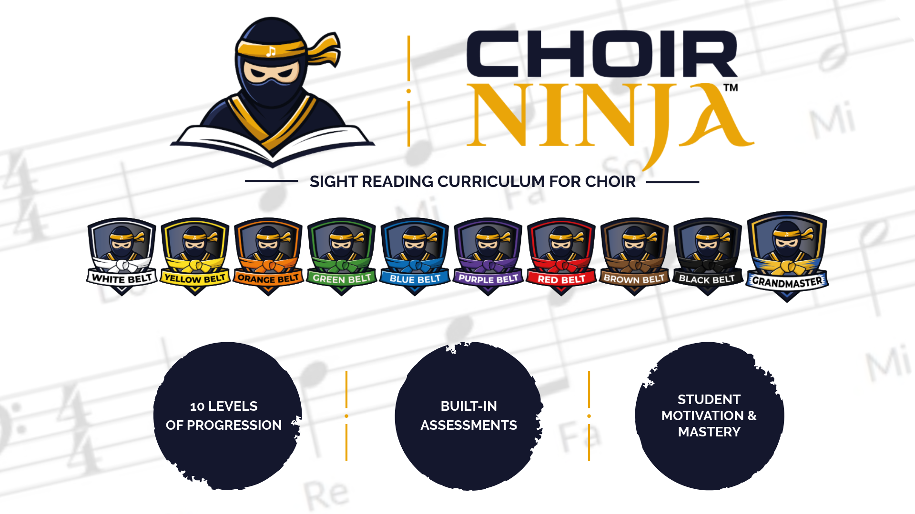

Slide 2

Lessons 1-4
+ More Practice Exercises
Level 1

Slide 3
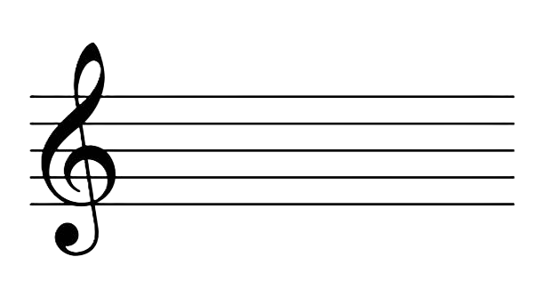


White Ninja | Lesson 1
Quarter Notes are 1 beat each
Do Re

Slide 4
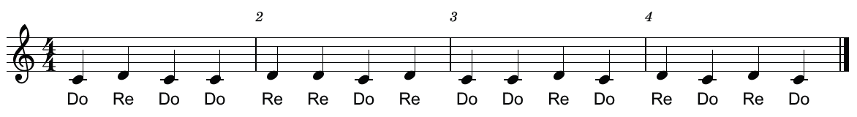
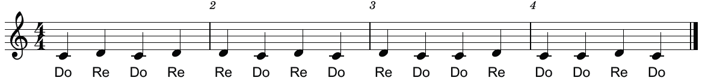
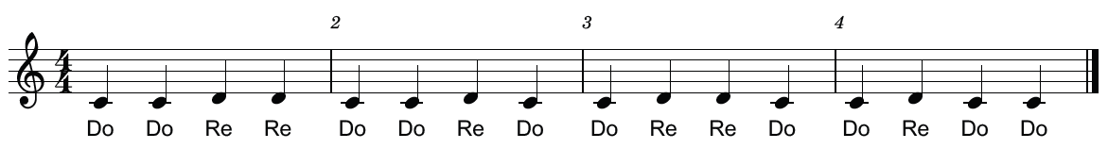
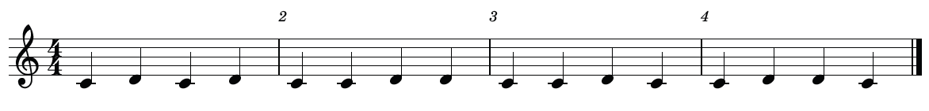
White Ninja | Lesson 1
1.
2.
3.
4.

Slide 5
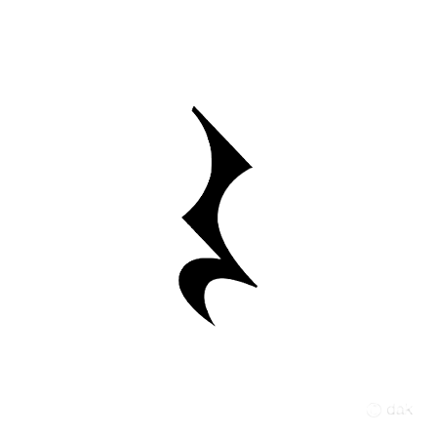
White Ninja | Lesson 2
Quarter Rests are 1 beat of silence each

Slide 6
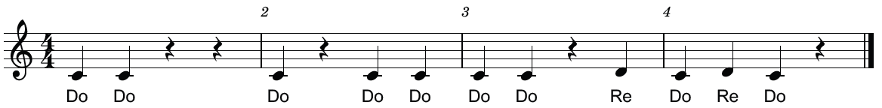
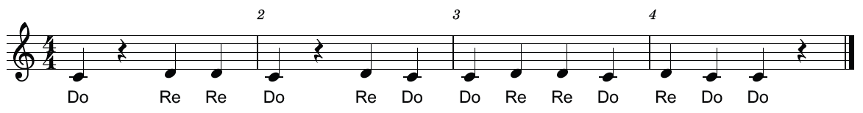
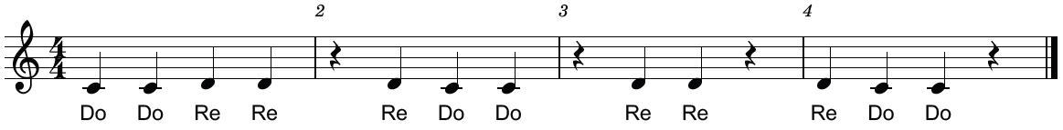
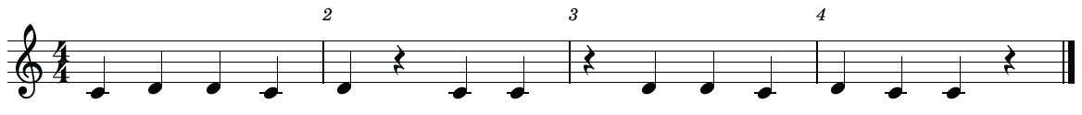
White Ninja | Lesson 2
1.
2.
3.
4.

Slide 7
White Ninja | Lesson 3
Do Re Mi

Slide 8
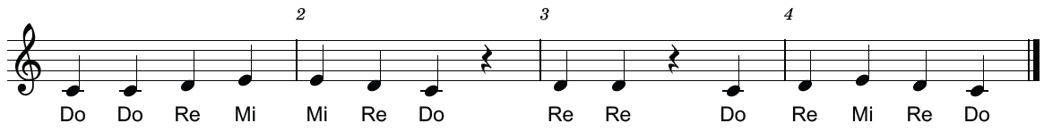
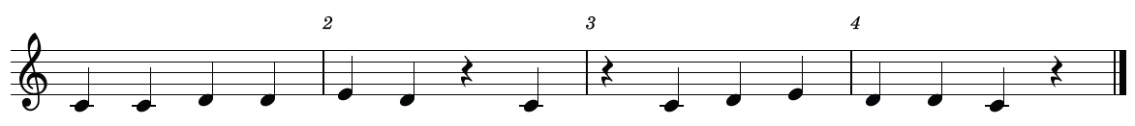
White Ninja | Lesson 3
1.
2.
3.
4.

Slide 9

White Ninja | Lesson 4
Half Notes are two beats each
1-2 3-4

Slide 10
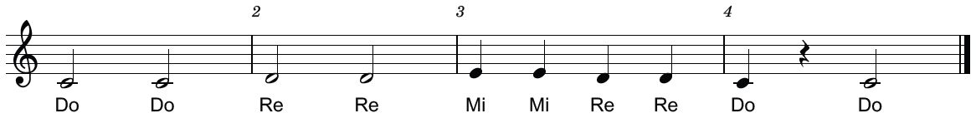
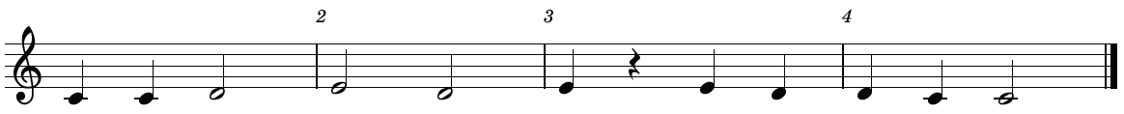
White Ninja | Lesson 4
1.
2.
3.
4.
5.

Slide 11
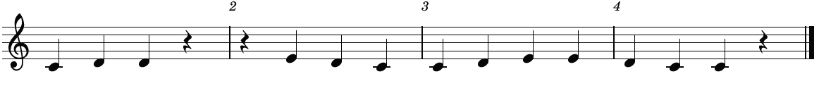
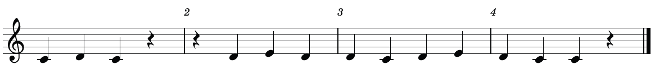
White Ninja | More Exercises 1
1.
2.
3.
4.
5.

Slide 12
White Ninja | More Exercises 2
6.
7.
8.
9.
10.

Slide 13

White Ninja | Rhythm Practice
Time Signatures
Beats in the measure
Type of note that gets the beat
1 2 3 4

Slide 14
White Ninja | Rhythm Practice 1
1.
2.
3.
4.
5.

Slide 15
White Ninja | Rhythm Practice 2
6.
7.
8.
9.
10.

Slide 16
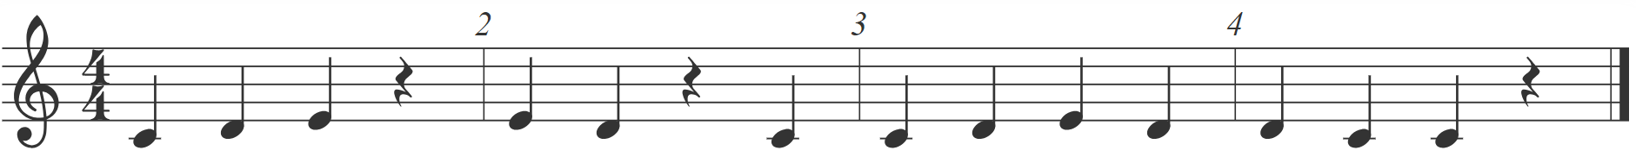
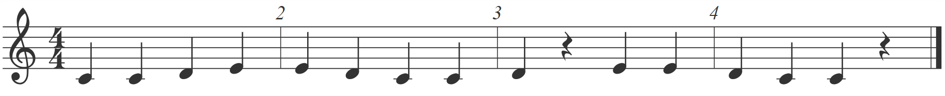
White Ninja | Test Exercises
1.
2.
3.
4.
5.

Slide 17
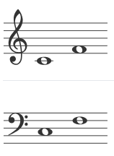



White Ninja | Sight Reading Factory Level Setup
Instrument | Range | Rhythm |  |  | Other | Pitch
Treble Clef: Sop, Alto Bass Clef: Tenor (8vb), Bass Rhythm Only |  | Note | Rest | Difficulty | None | Leaps
 |  |  |  | Easy |  | Max Leap | No Greater than 2nd | Must Start on Tonic

